Slide 1

Section 3 Project
Analysis & Recommendations for Northwind

Slide 2
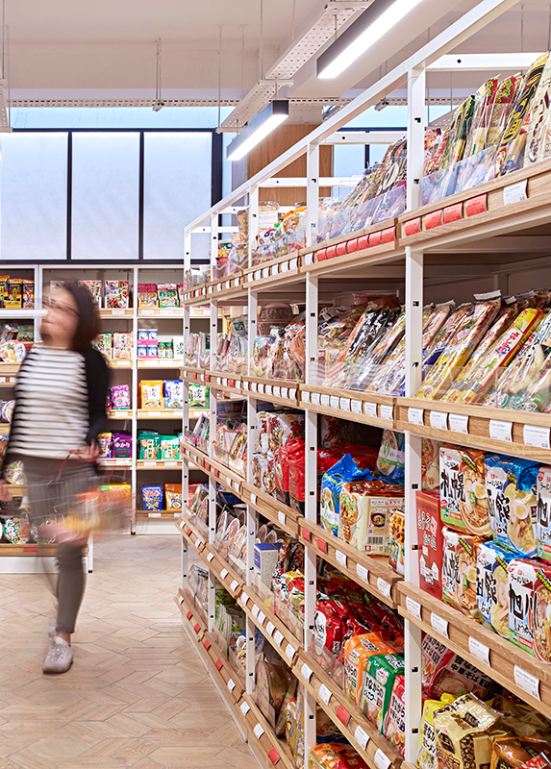
Executive summary
The business case
CB91’s findings:
Customer quality by region
Effects of discounting
Increasing order frequency
Cost of shipping firms
Possible next steps
Appendix contains additional analysis

Slide 3
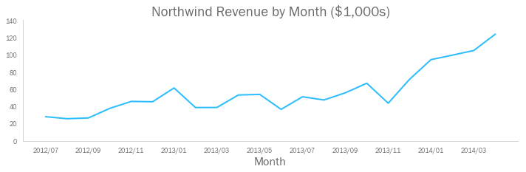
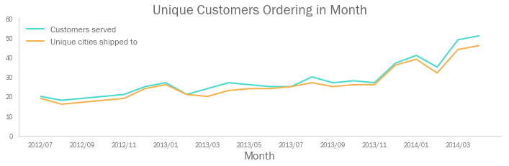
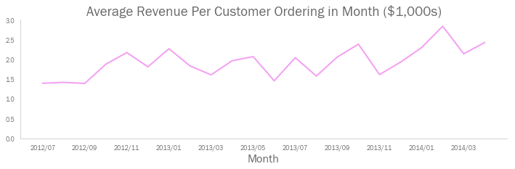
The business case
Northwind’s monthly revenues have grown quickly in the last 6 months
This is due to an increase in the number of customers, and geographic expansion
However, average revenue per customer is variable, and flat on average
Northwind should explore all potential opportunities to improve profitability

Slide 4
Expand into new markets
Increase number of customers
Double-down in existing markets
1) Which existing markets should Northwind focus on?
Increase revenues
Increase revenue per order
2) Does offering discounts increase the volume of products ordered?
Increase revenue per customer
Increase orders per customer
Increase Northwind profit
3) Do customers who order less frequently do so because they make bigger orders each time?
Reduce shipping costs
Reduce variable costs
4) Which shipping companies are cheapest in each region?
Reduce unit costs of goods
Reduce costs
Reduce cost of office premises
Reduce fixed costs
Reduce salary costs

Slide 5
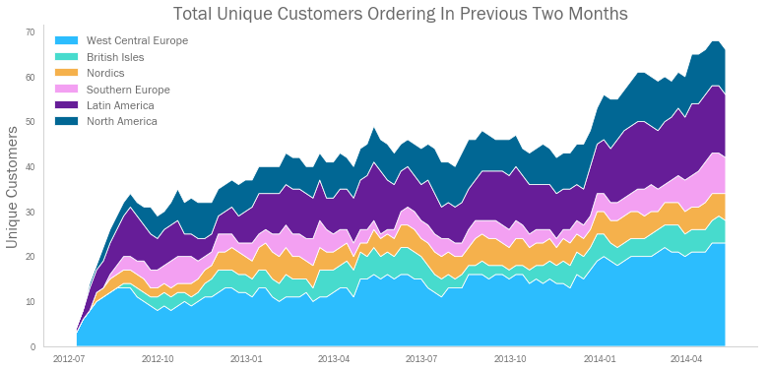
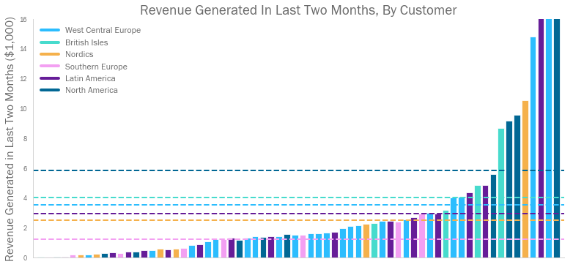
Customer quality by region
1
Customer Base
Customer expansion has been driven in Latin America, Southern Europe, and West/Central Europe.
There has been concern about the relative value of customers – particularly in Latin America and Southern Europe.
CB91 found that, though customers in these regions each generated less revenue on average, the differences were not statistically significant.
CB91 therefore recommends continued organic expansion across regions.
y-axis cut here. Max value = $24k

Slide 6
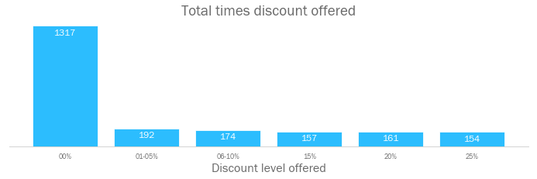
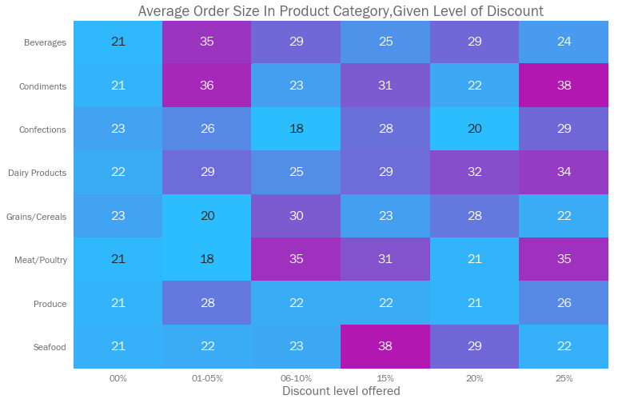
The effect of discounting
2
Revenue Per Order
Northwind could offer discounts more strategically. Some discount levels do not result in a significant uplift in sales. CB91 recommends discounting no more than the following in each given category:
Total value of discounts = $88,700
or 6.5% of total revenues
Category | Acceptable Discount
Beverages | 1-5%
Condiments | 1-5%
Confections | 25%
Dairy | 1-5%
Meat / Poultry | 6-10%
Seafood | 15%

Slide 7
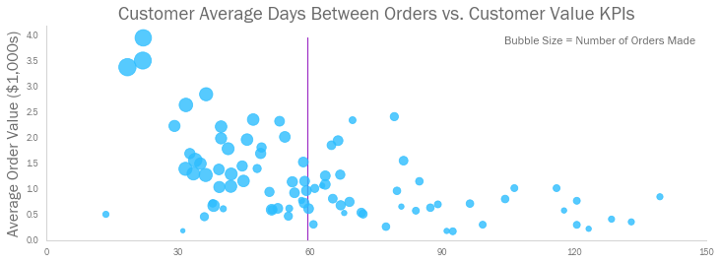
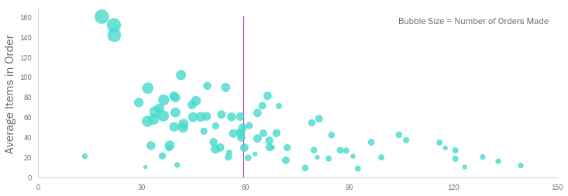
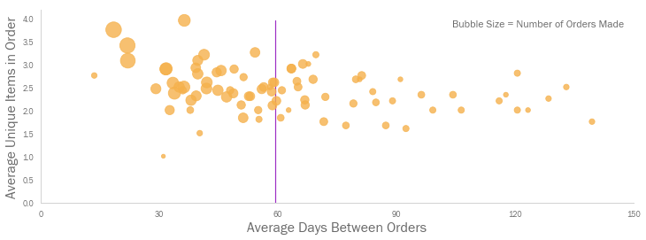
Increasing customer order frequency
Orders Per Customer
3
Could customers who make less frequent orders do so because they make bigger orders each time?
CB91 compared two customer cohorts – those that made at least one order every 2 months, and those that did not – and found that the opposite is true.
Customers making more than one order every 2 months, on average:
Make more valuable orders
Purchase more units per order
Include more unique types of product in each order
The mean gap between orders is 66 days

Slide 8
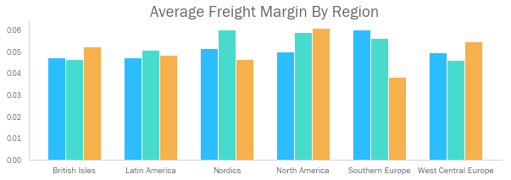
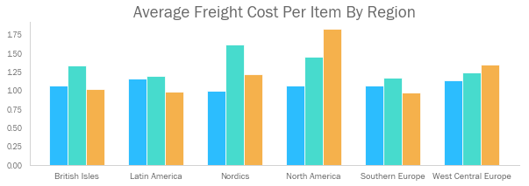
The cost of shipping firms
4
Variable costs
Three shipping companies are used across regions. CB91 ran tests across two cost KPIs to determine if any one company is significantly cheaper in a given region.
Region | Company to Use
British Isles | Any
Latin America | Any
Nordics | Speedy Express
North America | Speedy Express
Southern Europe | Federal Shipping
West / Central Europe | United Package
Speedy Express
United Package
Federal Shipping

Slide 9

Possible next steps
There are further hypotheses we could test to drive revenue and reduce cost:
A full investigation into the customer lifecycle – do orders increase as relationships mature?
Relative unit cost of goods from suppliers
Efficiency of Northwind’s stock ordering and inventory holding strategy
Employee salaries and the effect of sales incentives on performance

Slide 10
Thank you for your time
Further detail on the model, and additional analysis of the dataset is included in further pages

Slide 11
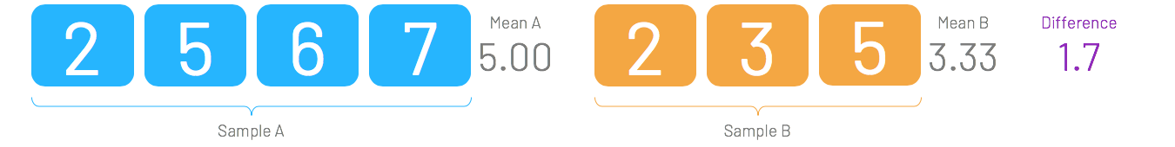
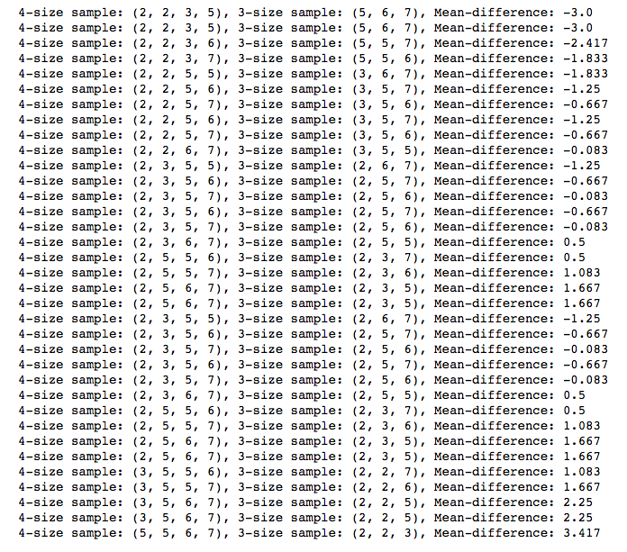
A note on Monte Carlo simulations (1/2)
Suppose we have two samples, of size 4 and 3 respectively. We can see that Sample A’s mean is 1.67 bigger than Sample B’s. Thus, we might want to conclude that Sample A is drawn from a different population than Sample B — one with a larger mean.
However, for the sake of argument, let’s suppose that A and B are drawn from the same population (take this as a null hypothesis). Now, if we were to observe the same 7 datapoints, but in a different permutation (still drawing samples of sizes 4 and 3) how likely is it that we would observe a mean difference that is larger than 1.67?
If we find that drawing samples of these sizes often creates mean differences larger than 1.67, then this difference clearly wasn’t very special in the first place — we can conclude that the two original samples are not significantly different.
Conversely, if we mostly see mean differences less than 1.67, then we can draw the opposite conclusion. Such a mean difference is unlikely, thus the two original samples are significantly different.
We therefore look at all the different ways that we could draw samples of size 4 and 3 from the 7 datapoints that we have.
We see that there are 3/35 instances (or 8.5%) where the mean difference is larger than 1.67. This percentage can be used in the same way as a p-value in a standard T-Test.
In other words, if we want to say with 95% certainty that the mean of Population A is greater than that of Population B (i.e, we want to use an alpha of 0.05), then we would need this value to be less than 5%.
Since 8.5% > 5%, we can not reject the null hypothesis that the two samples come from the same population. Sample A is not statistically different to Sample B, despite having a larger mean.

Slide 12
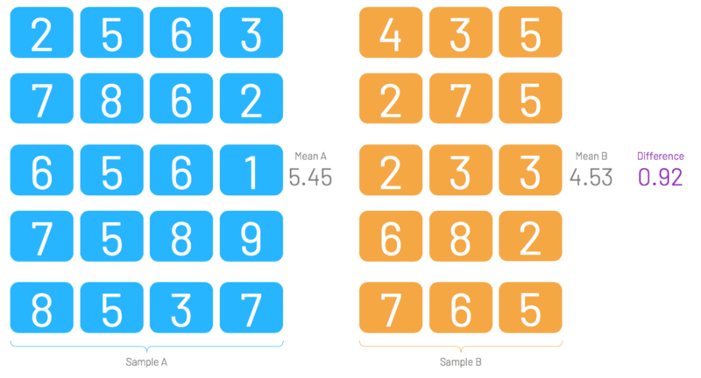
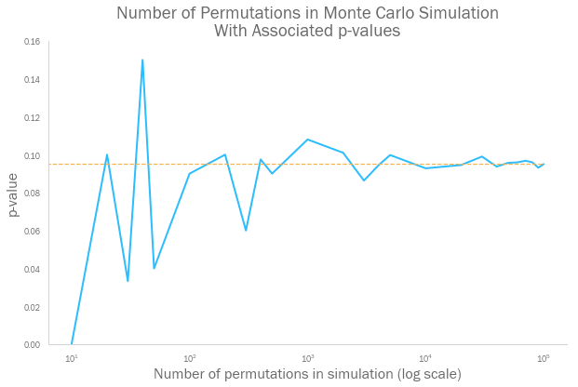
A note on Monte Carlo simulations (2/2)
The previous example with 7 datapoints is fine for explaining the theory of permutation tests. However, the number of possible permutations of two combined samples explodes as we increase the sample sizes. If we have two samples of size 140, for example, then there are more possible permutations of these 280 datapoints than there are atoms in the known universe.
This is the problem that the Monte Carlo simulation method deals with. Rather than working out all possible permutations (which can number in the billions of billions of billions), a Monte Carlo simulation takes a random sample of the possible permutations, and calculates the mean difference of those instead.
Let's create a new example with larger samples, of sizes 20 and 15. Suppose we combine the two samples, and take a series of 20 and 15 sized samples (taking the difference of their means each time). There are 3,247,943,160 possible ways to do this, however we do not need to look at each of these. Remember - the Monte Carlo method will only take a sample of these permutations.
How many permutations do we need to take before we can be confident in our answer? As we can see, the share of mean differences below 0.92 (the mean difference of the original pair of samples) starts to stabilise once our simulation looks at more than 10,000 permutations. By the time we're doing Monte Carlo simulations that look at 100,000 permutations, we can be pretty certain that our p-value will be close enough to the real thing.
In this case, the p-value is stabilising at around 0.095. Again, this is larger than our standard alpha of 0.05, thus we can not reject the null hypothesis - Sample A and Sample B are not significantly different, despite the difference in their means.

Slide 13
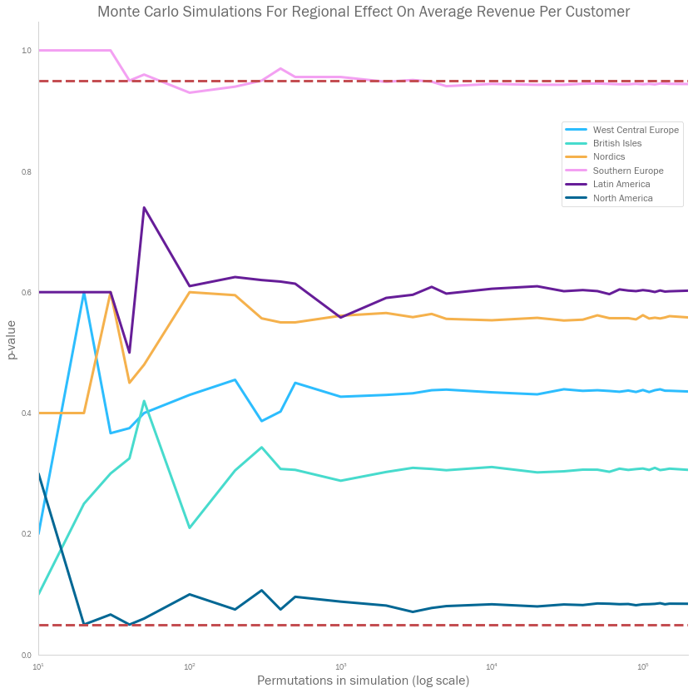
Customer quality by region – in more detail
CB91 ran Monte Carlo simulations across the revenue per customer across six regions
It used increasing simulations of increasing sizes in each test to investigate how the p-value stabilises in each case (up to a maximum of 200,000 simulations).
The hypotheses for each test took the following forms:
H₀: Revenue per customer in last two months in given region ≤ Revenue per customer in last two months in other regions
H_{a}: Revenue per customer in last two months in given region > Revenue per customer in last two months in other regions

Slide 14
The effect of discounting – in more detail
Product Category | Discount | Discount Levels Tested Against | P-Value | Reject
Dairy Products | 01-05% | ['00%'] | 0.01778 | Reject Null Hypothesis
Dairy Products | 06-10% | ['01-05%'] | 0.78404 | Do not reject Null Hypothesis
Dairy Products | 15% | ['01-05%', '06-10%'] | 0.37972 | Do not reject Null Hypothesis
Dairy Products | 20% | ['01-05%', '06-10%', '15%'] | 0.18030 | Do not reject Null Hypothesis
Dairy Products | 25% | ['01-05%', '06-10%', '15%', '20%'] | 0.14162 | Do not reject Null Hypothesis
Grains/Cereals | 01-05% | ['00%'] | 0.67286 | Do not reject Null Hypothesis
Grains/Cereals | 06-10% | ['00%', '01-05%'] | 0.09508 | Do not reject Null Hypothesis
Grains/Cereals | 15% | ['00%', '01-05%', '06-10%'] | 0.44500 | Do not reject Null Hypothesis
Grains/Cereals | 20% | ['00%', '01-05%', '06-10%', '15%'] | 0.17300 | Do not reject Null Hypothesis
Grains/Cereals | 25% | ['00%', '01-05%', '06-10%', '15%', '20%'] | 0.56216 | Do not reject Null Hypothesis
Produce | 01-05% | ['00%'] | 0.13576 | Do not reject Null Hypothesis
Produce | 06-10% | ['00%', '01-05%'] | 0.42064 | Do not reject Null Hypothesis
Produce | 15% | ['00%', '01-05%', '06-10%'] | 0.44978 | Do not reject Null Hypothesis
Produce | 20% | ['00%', '01-05%', '06-10%', '15%'] | 0.46266 | Do not reject Null Hypothesis
Produce | 25% | ['00%', '01-05%', '06-10%', '15%', '20%'] | 0.24806 | Do not reject Null Hypothesis
Seafood | 01-05% | ['00%'] | 0.40030 | Do not reject Null Hypothesis
Seafood | 06-10% | ['00%', '01-05%'] | 0.35570 | Do not reject Null Hypothesis
Seafood | 15% | ['00%', '01-05%', '06-10%'] | 0.00104 | Reject Null Hypothesis
Seafood | 20% | ['15%'] | 0.91012 | Do not reject Null Hypothesis
Seafood | 25% | ['15%', '20%'] | 0.98480 | Do not reject Null Hypothesis
Condiments | 01-05% | ['00%'] | 0.00098 | Reject Null Hypothesis
Condiments | 06-10% | ['01-05%'] | 0.95932 | Do not reject Null Hypothesis
Condiments | 15% | ['01-05%', '06-10%'] | 0.41854 | Do not reject Null Hypothesis
Condiments | 20% | ['01-05%', '06-10%', '15%'] | 0.85078 | Do not reject Null Hypothesis
Condiments | 25% | ['01-05%', '06-10%', '15%', '20%'] | 0.11268 | Do not reject Null Hypothesis
Confections | 01-05% | ['00%'] | 0.21176 | Do not reject Null Hypothesis
Confections | 06-10% | ['00%', '01-05%'] | 0.95098 | Do not reject Null Hypothesis
Confections | 15% | ['00%', '01-05%', '06-10%'] | 0.06132 | Do not reject Null Hypothesis
Confections | 20% | ['00%', '01-05%', '06-10%', '15%'] | 0.79054 | Do not reject Null Hypothesis
Confections | 25% | ['00%', '01-05%', '06-10%', '15%', '20%'] | 0.04660 | Reject Null Hypothesis
Beverages | 01-05% | ['00%'] | 0.00078 | Reject Null Hypothesis
Beverages | 06-10% | ['01-05%'] | 0.75652 | Do not reject Null Hypothesis
Beverages | 15% | ['01-05%', '06-10%'] | 0.91838 | Do not reject Null Hypothesis
Beverages | 20% | ['01-05%', '06-10%', '15%'] | 0.45816 | Do not reject Null Hypothesis
Beverages | 25% | ['01-05%', '06-10%', '15%', '20%'] | 0.87628 | Do not reject Null Hypothesis
Meat/Poultry | 01-05% | ['00%'] | 0.68886 | Do not reject Null Hypothesis
Meat/Poultry | 06-10% | ['00%', '01-05%'] | 0.00722 | Reject Null Hypothesis
Meat/Poultry | 15% | ['06-10%'] | 0.59106 | Do not reject Null Hypothesis
Meat/Poultry | 20% | ['06-10%', '15%'] | 0.90366 | Do not reject Null Hypothesis
Meat/Poultry | 25% | ['06-10%', '15%', '20%'] | 0.25610 | Do not reject Null Hypothesis
CB91 ran Monte Carlo simulations across each discount level for each product category
CB91 tested order sizes for a given discount level against all lower discount levels that did not result in statistically significant increases in order sizes
Each test used 50,000 simulations, with an alpha of 0.05
The hypotheses for each test were also automated, taking the following forms:
H₀: Order sizes of product category at discount level ≤ order sizes at lower discount levels
H_{a}: Order sizes of product category at discount level > order sizes at lower discount levels

Slide 15
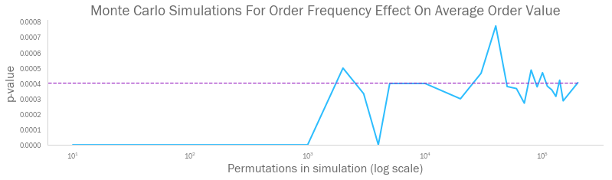
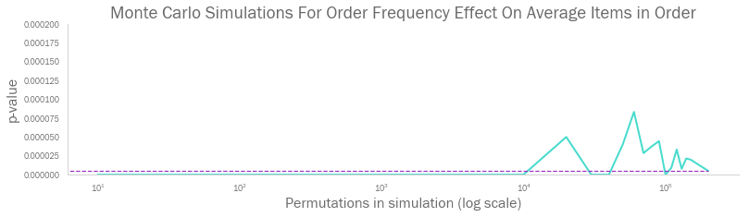
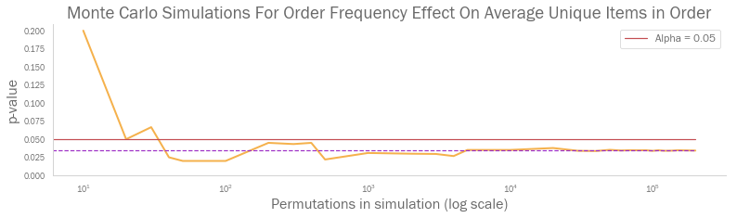
Customer order frequency – in more detail
CB91 ran Monte Carlo simulations across three customer value KPIs
It used increasing simulations of increasing sizes in each test to investigate how the p-value stabilises in each case (up to a maximum of 200,000 simulations).
The hypotheses for each test took the following forms:
H₀: Given KPI for customers ordering less than once every two months ≤ Given KPI for customers ordering more than once every two months
H_{a}: Given KPI for customers ordering less than once every two months > Given KPI for customers ordering more than once every two months

Slide 16
The cost of shipping firms – in more detail
Company | Region | KPI | Comparison to Others | P-Value | Reject
Speedy Express | West Central Europe | Freight Margin | Less | 0.49296 | Do not reject Null Hypothesis
Speedy Express | West Central Europe | Freight Cost Per Item | Less | 0.17020 | Do not reject Null Hypothesis
Speedy Express | Latin America | Freight Margin | Less | 0.31006 | Do not reject Null Hypothesis
Speedy Express | Latin America | Freight Cost Per Item | Greater | 0.40138 | Do not reject Null Hypothesis
Speedy Express | North America | Freight Margin | Less | 0.30510 | Do not reject Null Hypothesis
Speedy Express | North America | Freight Cost Per Item | Less | 0.04936 | Reject Null Hypothesis
Speedy Express | Nordics | Freight Margin | Less | 0.37700 | Do not reject Null Hypothesis
Speedy Express | Nordics | Freight Cost Per Item | Less | 0.04330 | Reject Null Hypothesis
Speedy Express | Southern Europe | Freight Margin | Greater | 0.04454 | Reject Null Hypothesis
Speedy Express | Southern Europe | Freight Cost Per Item | Less | 0.49180 | Do not reject Null Hypothesis
Speedy Express | British Isles | Freight Margin | Less | 0.40284 | Do not reject Null Hypothesis
Speedy Express | British Isles | Freight Cost Per Item | Less | 0.37556 | Do not reject Null Hypothesis
United Package | West Central Europe | Freight Margin | Less | 0.04186 | Reject Null Hypothesis
United Package | West Central Europe | Freight Cost Per Item | Less | 0.49992 | Do not reject Null Hypothesis
United Package | Latin America | Freight Margin | Greater | 0.27982 | Do not reject Null Hypothesis
United Package | Latin America | Freight Cost Per Item | Greater | 0.30470 | Do not reject Null Hypothesis
United Package | North America | Freight Margin | Greater | 0.41868 | Do not reject Null Hypothesis
United Package | North America | Freight Cost Per Item | Greater | 0.59066 | Do not reject Null Hypothesis
United Package | Nordics | Freight Margin | Greater | 0.06632 | Do not reject Null Hypothesis
United Package | Nordics | Freight Cost Per Item | Greater | 0.02202 | Reject Null Hypothesis
United Package | Southern Europe | Freight Margin | Greater | 0.24076 | Do not reject Null Hypothesis
United Package | Southern Europe | Freight Cost Per Item | Greater | 0.24450 | Do not reject Null Hypothesis
United Package | British Isles | Freight Margin | Less | 0.27622 | Do not reject Null Hypothesis
United Package | British Isles | Freight Cost Per Item | Greater | 0.12556 | Do not reject Null Hypothesis
Federal Shipping | West Central Europe | Freight Margin | Greater | 0.02996 | Reject Null Hypothesis
Federal Shipping | West Central Europe | Freight Cost Per Item | Greater | 0.16532 | Do not reject Null Hypothesis
Federal Shipping | Latin America | Freight Margin | Less | 0.46678 | Do not reject Null Hypothesis
Federal Shipping | Latin America | Freight Cost Per Item | Less | 0.23416 | Do not reject Null Hypothesis
Federal Shipping | North America | Freight Margin | Greater | 0.35682 | Do not reject Null Hypothesis
Federal Shipping | North America | Freight Cost Per Item | Greater | 0.06570 | Do not reject Null Hypothesis
Federal Shipping | Nordics | Freight Margin | Less | 0.11028 | Do not reject Null Hypothesis
Federal Shipping | Nordics | Freight Cost Per Item | Less | 0.37198 | Do not reject Null Hypothesis
Federal Shipping | Southern Europe | Freight Margin | Less | 0.00364 | Reject Null Hypothesis
Federal Shipping | Southern Europe | Freight Cost Per Item | Less | 0.25942 | Do not reject Null Hypothesis
Federal Shipping | British Isles | Freight Margin | Greater | 0.20586 | Do not reject Null Hypothesis
Federal Shipping | British Isles | Freight Cost Per Item | Less | 0.20116 | Do not reject Null Hypothesis
CB91 ran a Monte Carlo simulation across all permutations of shipping company, region, and cost KPI
Each test used 50,000 simulations, with an alpha of 0.05
The hypotheses for each test were also automated, taking the following forms:
H₀: Company KPI in region = KPI in region of other two companies
H_{a}: Company KPI in region {<, >}* KPI in region of other two companies
* nature of inequality is automatically determined based on whether company’s average cost in that KPI was above or below the market average

Slide 17
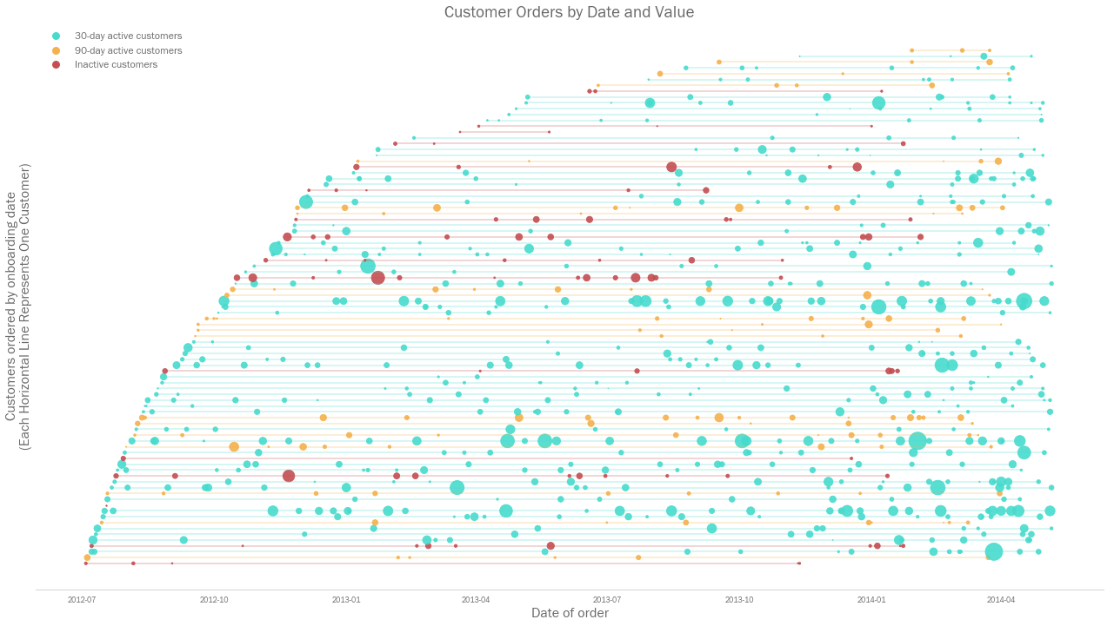
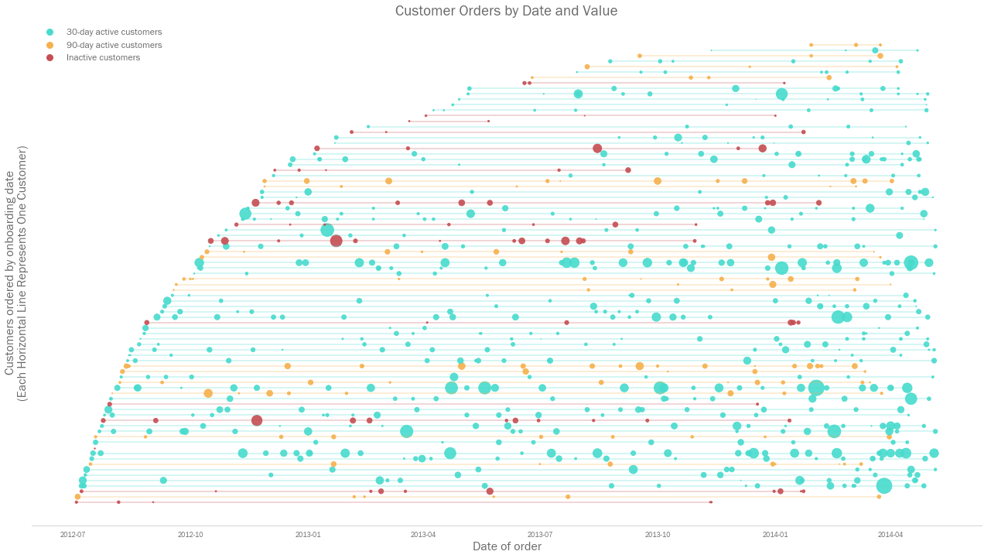
A lifetime view of Northwind’s orders
Additional Analysis
Each horizontal line represents the time line of one customer, and each circle represents an individual order that they have made. Circle size represents the value of that order.

Slide 18
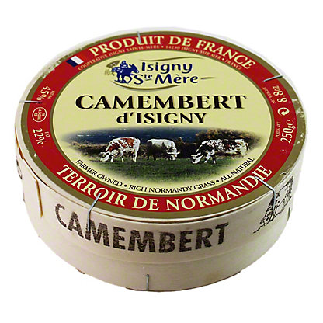
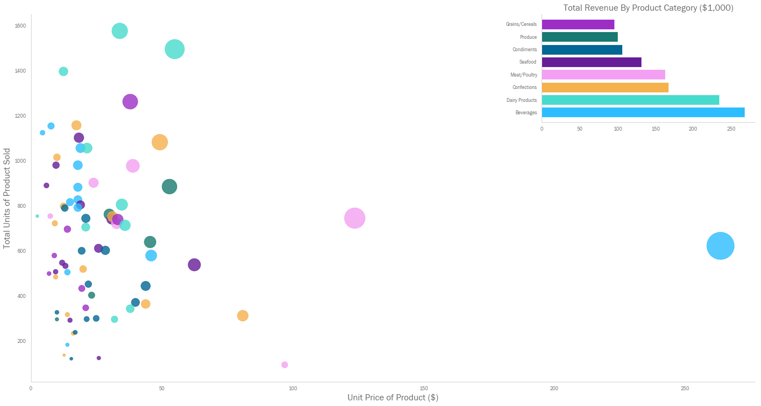

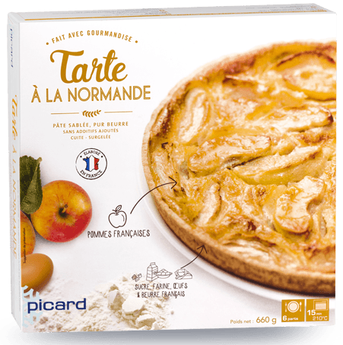
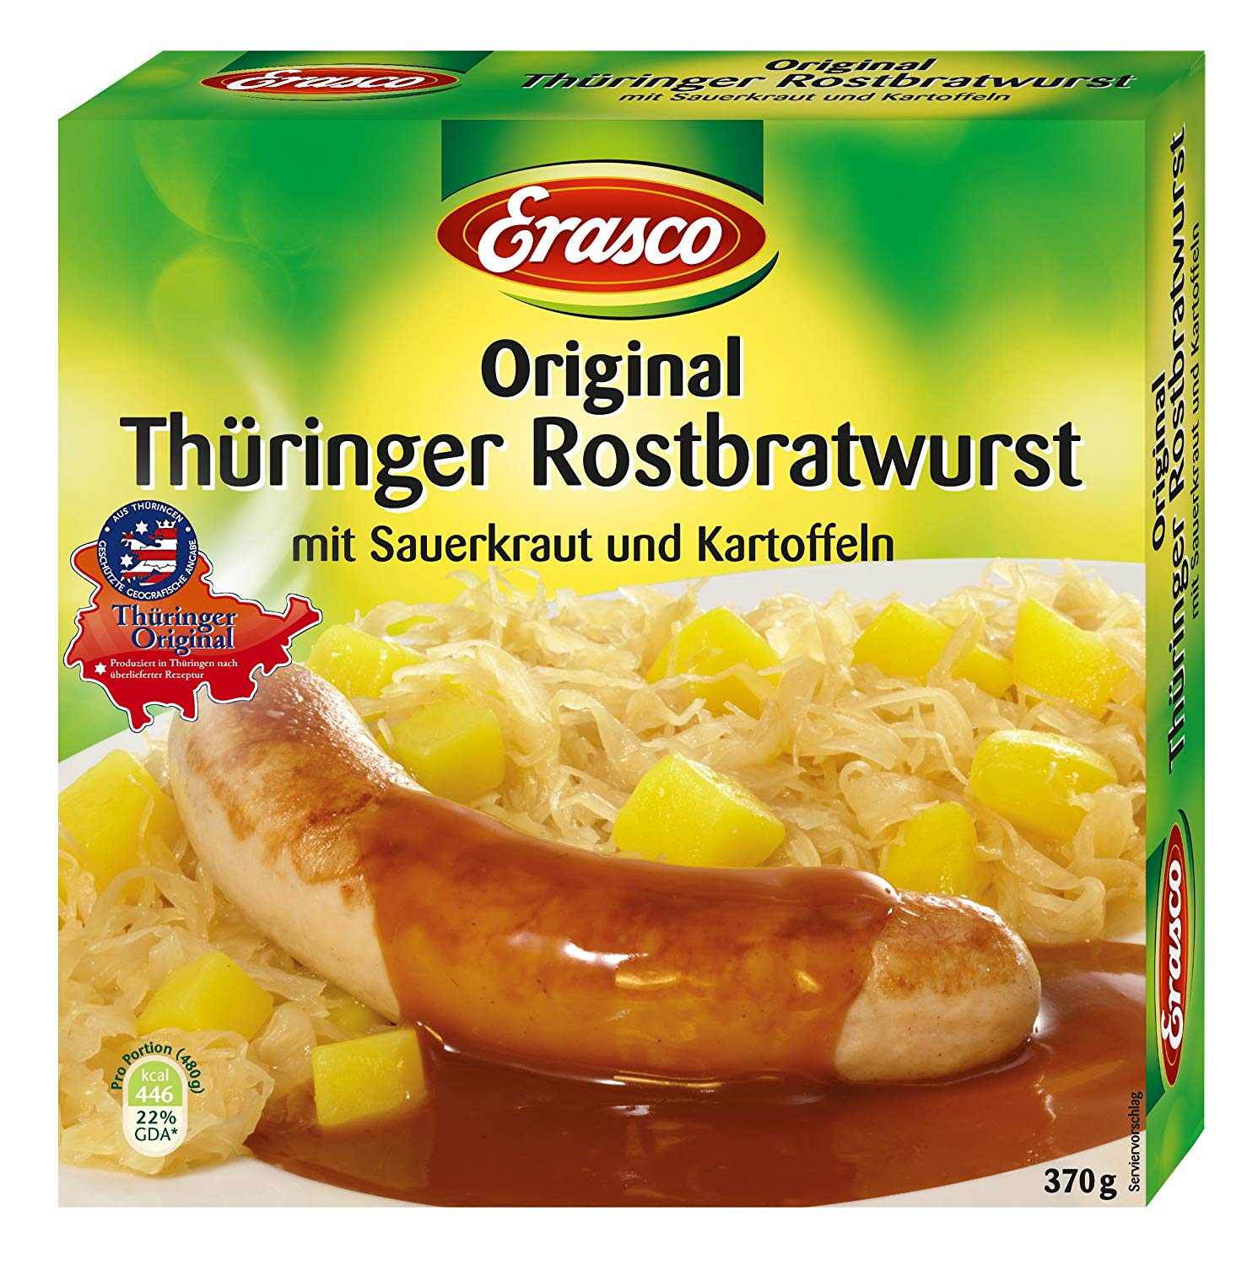
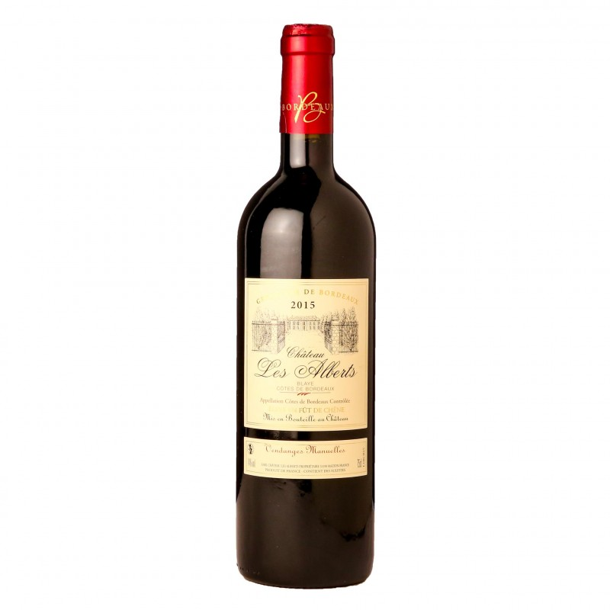
Northwind’s product portfolio
Additional Analysis
Camembert Pierrot
Total revenue: $46,825
Bubble size = Total revenue generated by product
Raclette Courdavault
Total revenue: $71,151
Tarte au Sucre
Total revenue: $47,234
Thüringer Rostbratwurst
Total revenue: $80,368
Côte de Blaye
Total revenue: $141,397

Slide 19
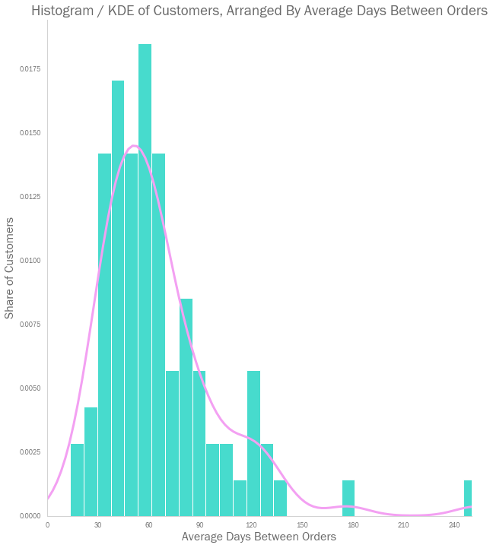
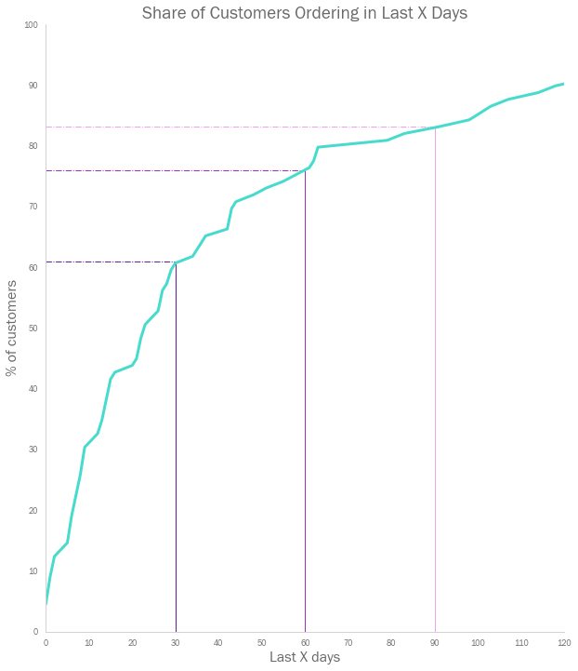
Northwind customer engagement
Additional Analysis
The majority of customers make an order on average every 30-60 days
Over 60% of customers made an order in the last 30 days, and over 75% made an order in the last 60 days.

